Slide 1

Applying Business Analytics to EFL
Instructor: Hrant Davtyan
Team Players: Henrik Sergoyan, Nare Krmoyan Gevorg Ekhtoyan

Slide 2
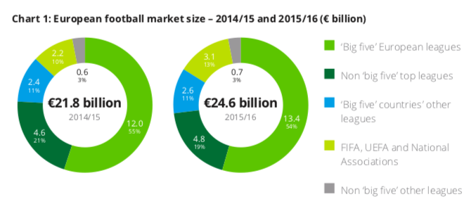
Did you know?
The ‘Big Five’ European leagues grew collective revenues by €1.4 billion (12%) in 2015/16.
Big Five = { England: EPL,
Germany: Bundesliga,
Spain: La Liga,
Italy: Serie A,
France: League 1 }

Slide 3
Problem
Explore the differences & similarities between ”Big Five” teams’ home & away performances
Design a predictive model based on the insights
Help the investors and “smart bettors” make wiser choices!

Slide 4
Explorations
In general, similar metrics for home & away matches are positively correlated
At 95% significance level, no significant difference for home & away plays for procedural metrics but some significant difference for success metrics
As an investor or a “smart bettor”, consider learning a bit of behavioral economics in line with data science 😂

Slide 5
Explorations [cont’d]
Serie A has the highest mean score for shots but the lowest accuracy both for home & away games. Beware! Don’t be fooled!
Ligue 1 has the worst away performance. Keep in Mind!
Bundesliga has the highest mean home & away ratings. Yet EPL has the highest valuation according to KPMG & Deloitte🤨

Slide 6
Explorations [cont’d]
Std Deviations are higher for La Liga both home & away
Leagues with many similar-level teams have lower variances but not much higher mean performances
Mean goal accuracy is the highest for La Liga. Yet, remember the variance!

Slide 7
Explorations [cont’d]
Both home & away Barcelona, Real Madrid, PSG & Bayern have the highest goal accuracy
In case you’re interested, check our ipython notebook! There’s so much more!

Slide 8
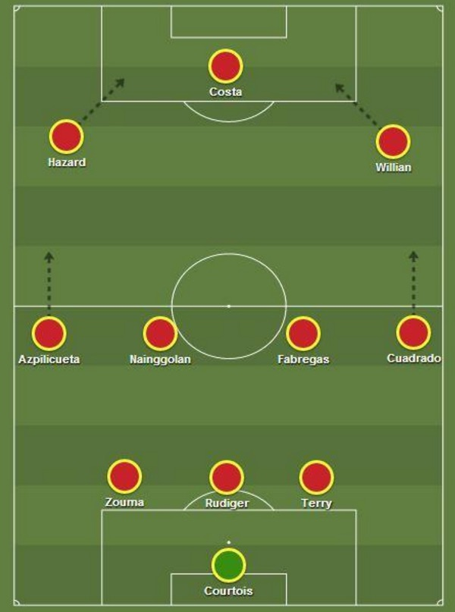
The most offensive formation is 3-4-3 (d)
On average 2.7 goals per game for home teams and 1.77 for away teams

Slide 9

Gianluigi Buffon
Most number of clean-sheets and saves per-match

Slide 10
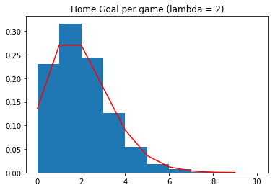
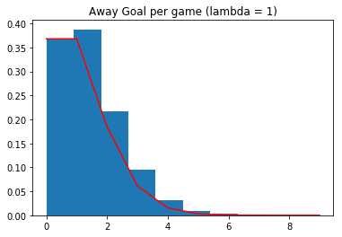
Poisson distribution

Slide 11

Skill vs Luck

Slide 12
Model Results
Tree-based Algorithms & NN got similar accuracy and recall scores (except KNN).
Principal Component Analysis(PCA) was not useful.
After reducing the possible outcomes of target variable accuracy increased from 50% to 70%.
GB could have been useful but we didn’t have the
computational power.

Slide 13
Conclusive Remarks
Do you want to check our model?
There’s is a nice match tonight: Real - Villareal

Slide 14

Thank You!

